Slide 1
Improving Connection
Reducing Intake No Show Rate
Notes:
Introduce who I am, where I’m from, one line about Outreach.
My name is Dan O’Brien, I work as a psychiatric nurse practitioner at Outreach Community Health Centers. Outreach is a community health center on Capitol that offers medical, behavioral and dental care for the whole family.

Slide 2
The Goal and Plan
To reduce the no show rates for behavioral health intakes over the course of Q1 in 2022.
To do this, we made an effort to have our intake coordinator sign people up for patient portal called MyChart during the scheduling phone call.
They did this by sending patients a link to their phone or email, or giving them step-by-step instructions on how to sign up online.
Notes:
The previous intake coordinator did a brief literature review and found some research has been done that indicates that people who are signed up for the patient portal before their intake appointment are more likely to attend the appointment.
MyChart is a patient portal where patients can view labs, send messages and otherwise communicate with their healthcare team.

Slide 3
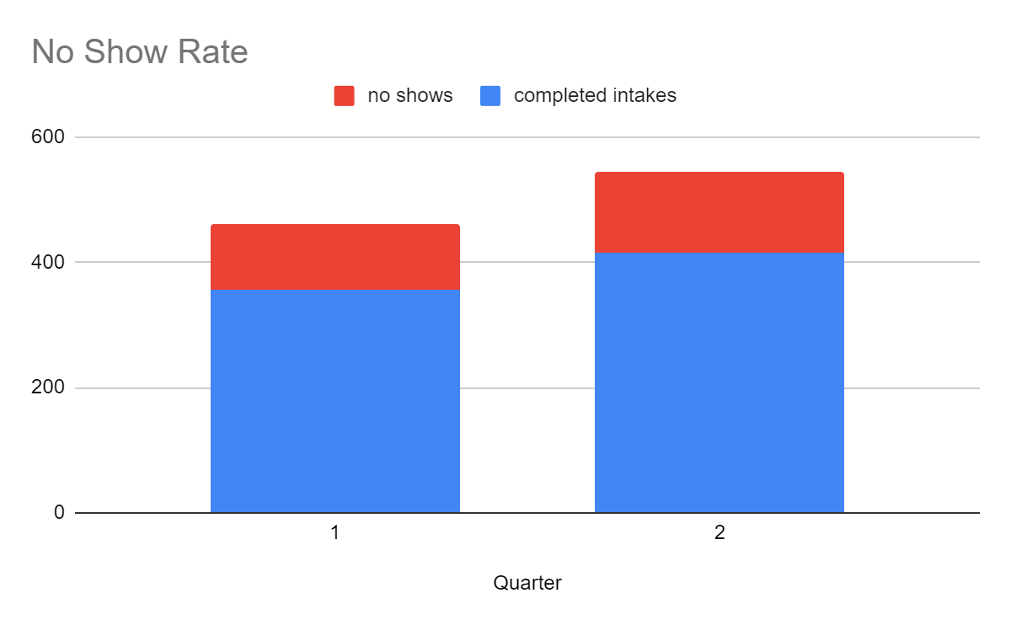
Results
Q1 no show rate: 30%
Q2 no show rate: 31%
Notes:
We measured the no-show rate pre-intervention through running a report in EPIC, and then measured it again post-intervention.
Intervention was trialed for Q2, from April 1st-June 30th.
Q1 106 no shows and 356 completed intakes, total of 462 scheduled apts.
Q2 130 no shows and 415 completed intakes, total of 545 scheduled apts.
Just report on K.D. as she was the intervention.
17% activation just for K.D. 4 people signed up.
18% activation just for K.D. 2 people signed up.
23% activation for Q1 of MyChart for all of BH
24% activation for Q2 of MyChart for all of BH

Slide 4
Impact/lessons learned
May need secondary metrics
The intake coordinator reported that many that she talked to about the patient portal were either not interested in it or didn’t have a phone that could work.
Lesson learned-sometimes what may be evidence based may not apply to your population.
Notes:
Wonder if the no show rate is different for psychiatry vs counseling.
Secondary metric of how many said no to sign up

Slide 5
Next steps
Hire an intake coordinator.
Back to the drawing board.
Notes:
Maybe continue to have intake coordinator set up Mychart for improving patient communication down the line, but not for the express purpose of improving intake rate.
Back to the drawing board; assess what factors impact the no show rate through a patient survey.

