Slide 1
Children’s Mobile Crisis and Crisis Mobile Team Integration Niatx Project
Hannah Keil - Crisis Services Coordinator
Lauren Hubbard - Director of Community Crisis Services

Slide 2
Aim (Plan)
There will be an increase in youth served as a result of Children’s Mobile Crisis (CMC) & Crisis Mobile Team (CMT) integrated into a shared office space and responding as an integrated team.

Slide 3
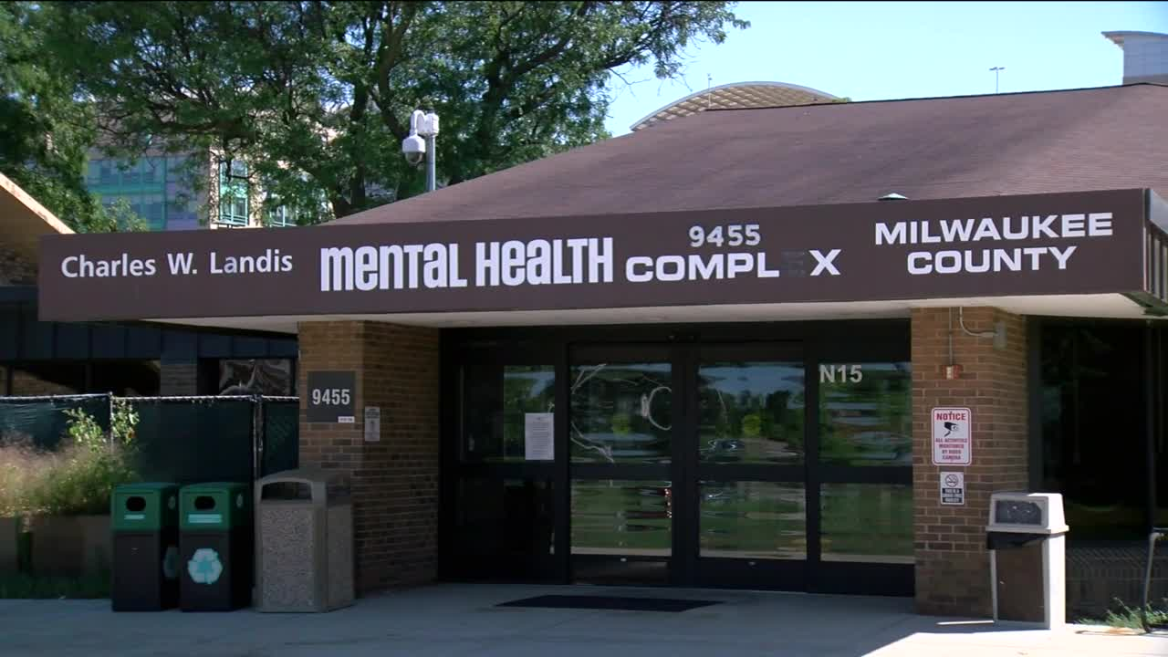
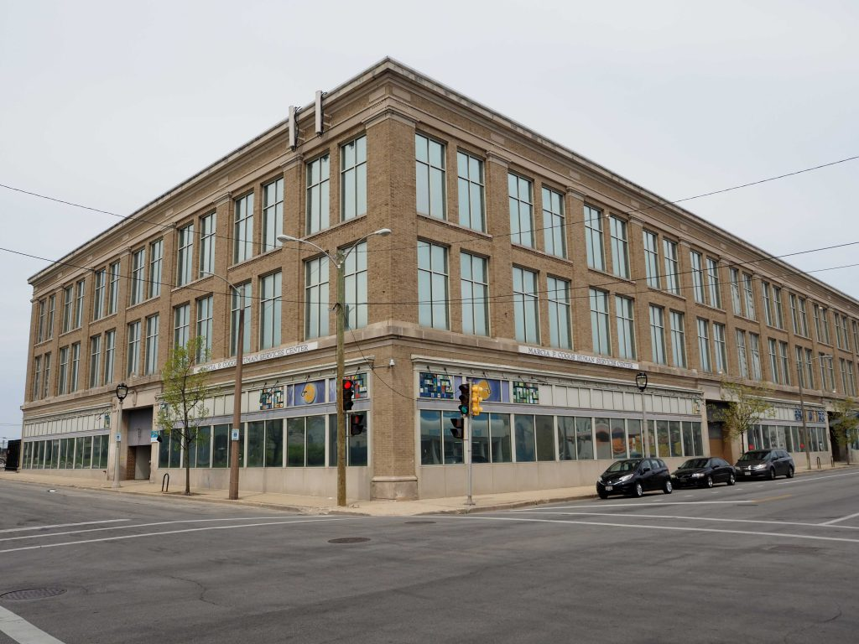
Changes (Do)
On 10/27/22, CMC & CMT relocated from the Milwaukee County Behavioral Health Hospital (where the teams maintained separate offices), to the Marcia Coggs Human Services building.
At the Marcia Coggs building the teams started working out of the same call center space and responding as a united team.
Notes:
Aim: Increase number of youth served
Change: Integration of offices and responding as a united team
Baseline measure: Two weeks pre-Integration at BHS (10/12/22 – 10/26/22)
Date of Change: First day of site integration (10/27/22)
Goal measure: Two week post-integration at Coggs (10/27/22 – 11/10/22)

Slide 4
Results
Mobiles: A mobile is a face-to-face visit which entails assessment, intervention, and often linkages to services. Youth mobiles are mobiles with an identified client under the age of 18.
10/12/22 – 10/26/22
Notes:
What is a mobile? -- A mobile is a face-to-face visit which entails assessment, intervention, and often linkages to services. Youth mobiles are mobiles with an identified client under the age of 18.
10/12/22 – 10/26/22 – Two weeks prior to the team integration. Both teams were working out of BHS in two separate spaces and largely responding separately to mobiles. During this two week time frame the total number of youth mobiles completed by BOTH teams (CMC and CMT) was 56 youth mobiles.
10/27/22 – 11/10/22 – Two week period post integration following the move to the Coggs building on 10/27/22. Both teams were working together collaboratively out of the shared call center area at the Coggs building. During this timeframe there was a total of 72 youth mobiles completed.
This was a 28.6% percentage increase in mobiles with youth post integration.

Slide 5
Results (continued)
Follow up: Clinicians complete follow ups after crisis line calls and mobiles. A follow up is a post assessment/intervention contact with a client and/or their supports. Follow ups are completed via phone or in-person. During a follow up, clinicians re-assess needs, monitor for and assist with linkages, and more.
Notes:
What is a follow up? -- Clinicians complete follow ups after crisis line calls and mobiles. A follow up is a post assessment/intervention contact with a client and/or their supports. Follow ups are completed via phone or in-person. During a follow up, clinicians re-assess needs, monitor for and assist with linkages, and more.
10/12/22 – 10/26/22 – Two weeks prior to the team integration. Both teams were working out of BHS in two separate spaces and largely completing follow ups separately. During this two week time frame, there was a the total number of 45 youth follow ups completed.
10/27/22 – 11/10/22 – Two week period post integration. Both teams were working together collaboratively out of the shared call center area at the Coggs building. During this timeframe there was a total of 96 youth follow ups that were completed. CMC clinicians were completing *most* youth follow ups post integration, however had additional support from their CMT peers with answering phone calls, responding to mobiles, and other responsibilities.
This was a 113.3% percentage increase in follow ups completed for youth post integration.

Slide 6
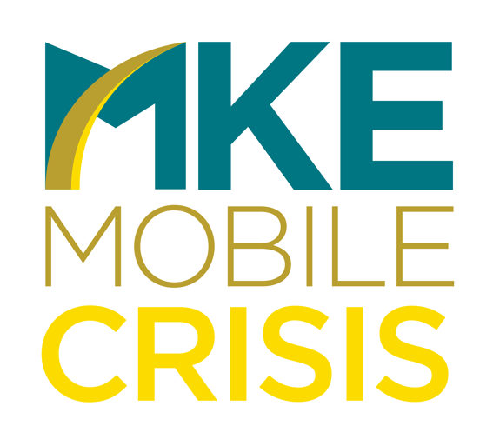
Next Steps (Act)
How did you decide to adopt, adapt, abandon the change?
Adopt
The teams have remained integrated and continue to operate as a united team, now known as Milwaukee Mobile Crisis.
While there have been many steps to the integration process – working out of the shared space and responding collaboratively has resulted in an increased response to youth related mobiles and follow ups completed for youth.
Notes:
Other aspects of integration:
Using same processes – TDS processing, forms, assessment tools, documentation expectations
Using the same EHR
Training, job description (expectations)
Other challenges – Contracted staff vs. county staff, barriers associated with moving

Slide 7
Impact
How did this project impact your customers and your organization?
Reaching an increased number of youth (and families) in the community
Providing a greater level of support through increased follow ups
Rebranding and rebuilding the reputation of mobile services for youth
Improving the Milwaukee County DHHS “No Wrong Door” approach to seeking services

Slide 8
Impact
What’s next?
The next phase of CMC & CMT integration...
Alignment of Electronic Health Records (EHR) – CMC: Synthesis to AVATAR
On 1/1/23, CMC was exclusive using AVATAR for documentation, billing, and mobile data tracking in alignment with CMT.
Area of focus: “CMT Console Form” was fully being utilized to track youth mobiles, including response times. This feature was not present in Synthesis.
Next exploring if there was a decreased response times on mobiles for youth as a result of this next phase of integration.

Slide 9
Questions?

