Slide 1
Boost Morale with Rationale
Employee Satisfaction Survey
Riverstone Counseling & Crisis Services
The Change Team:
Executive Sponsor: Tami Coleman
Change Leader: Tami Coleman
Change Team: Marquitta McGowan, Melissa Meyler-Warlow

Slide 2
Purpose
Our aim is to engage staff in activities that will promote employee morale and lead to an increase in motivated employees.
Employee morale is a measure that assesses job satisfaction and commitment, as well as the motivation and enthusiasm of an individual within the workplace.
Employee morale is influenced by how workers perceive their work, their leaders, their work environment, and how they fit into it.
Studies have shown that when employees are more satisfied with their organization, productivity increases and turnover rate decreases. Recognizing and empowering employees can increase motivation and improve performance across the organization.
Having happy, healthy, and engaged workers is also good for a company’s bottom line (Novotoney, 2010)
Novotney, A. (2010, December 1). Boosting morale. American Psychological Association. Retrieved April 1, 2023, from https://www.apa.org/monitor/2010/12/morale

Slide 3
Data Collection
Employee Satisfaction Survey
Method
18 questions, anonymous, Google Forms
Likert-type scale (1-4)
“Strongly Disagree”, “Disagree”, “Agree”, and “Strongly Agree”
3 constructs
Agency satisfaction
Management satisfaction
Self satisfaction
Pre-test: June 1st , 2023 – 15 participants
Boosting morale intervention
Employee appreciation
Management support
Post-test: October 1st, 15 participants
Notes:
18 questions with 3 variable focuses aka “constructs” (Agency satisfaction, management satisfaction, and self satisfaction) on a Likert-type scale of 1-4 with 1 being “Strongly Disagree” and 4 being “Strongly Agree”.
To increase responses, the survey was offered anonymously. With 15 participants for the pre-test, the survey responses for the post-test were stopped after the 15th participants.
In between pre-test and post-test, an intervention to boost morale with employee appreciation and management support components. This included a staff appreciation lunch, public and private acknowledgement for employees, and weekly 1:1 supervisor support sessions.

Slide 4
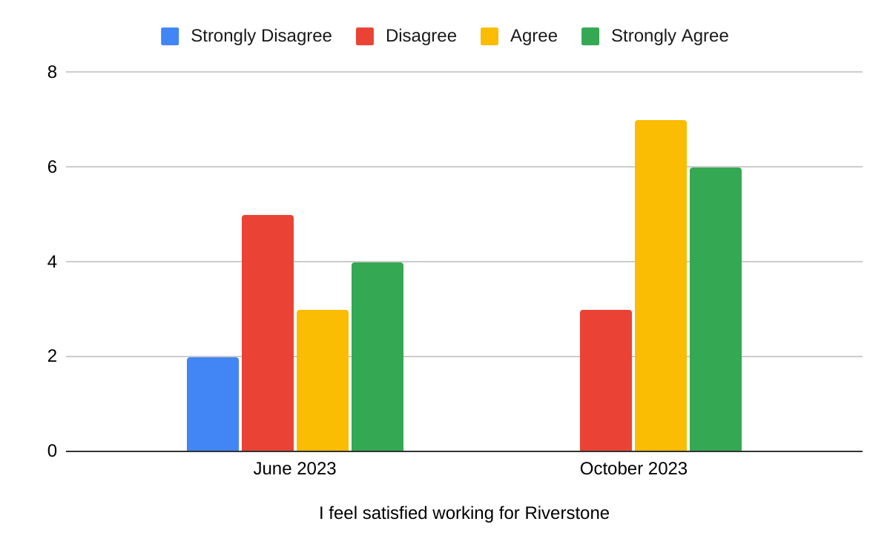
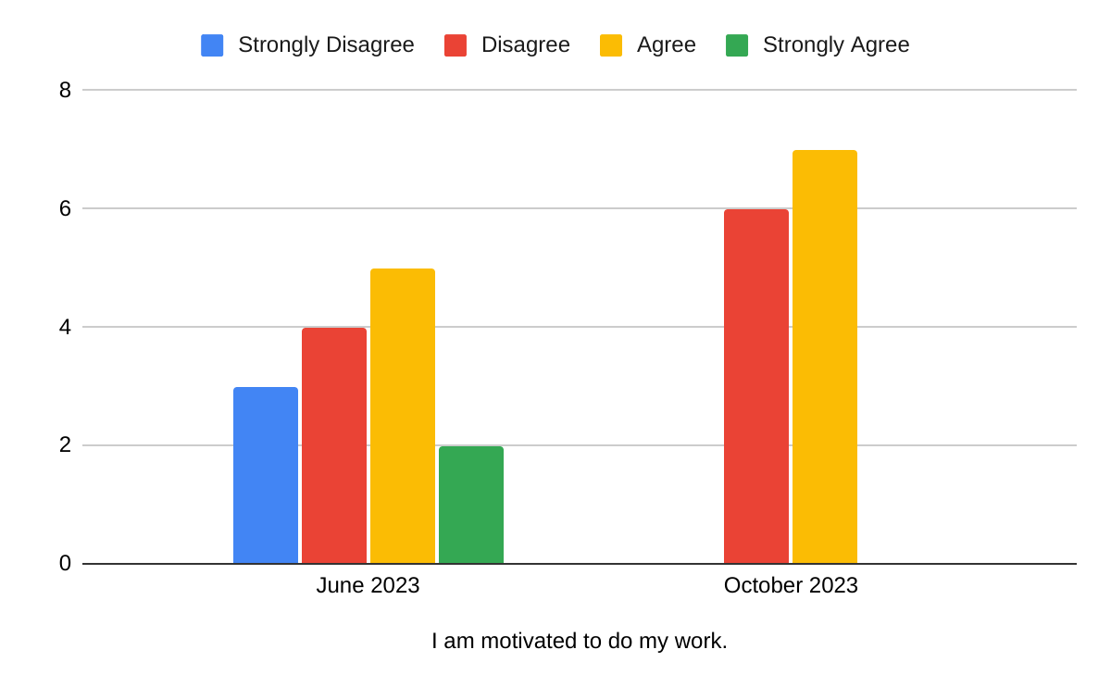
Results
Notes:
Overall, the results showed responses such as graph 1 in which answers were more varied in June 2023 and, in October 2023, there were more skewed answers towards positive answers (“Agree” and “Strongly Agree”)
For graph 2, it was observed that more extreme answers (“Strongly Disagree” and “Strongly Agree”) in June 2023 that showed more mild answers (“Disagree” and “Agree”) in October 2023

Slide 5
Future Implications
Further work in boosting employee morale could incorporate employee career focuses, turnover rate, continuing education hours, and repeated testing.
While this was only a pilot, further development can be done by enhancing the item sets from previously made surveys to increase internal consistency and construct validity.
Overall, the boost of Riverstone’s morale seemed to improve after the intervention of employee appreciation and management support.

